Slide 1
Nanoparticles in PTSD and (m)TBI treatment
Eric Graack

Slide 2
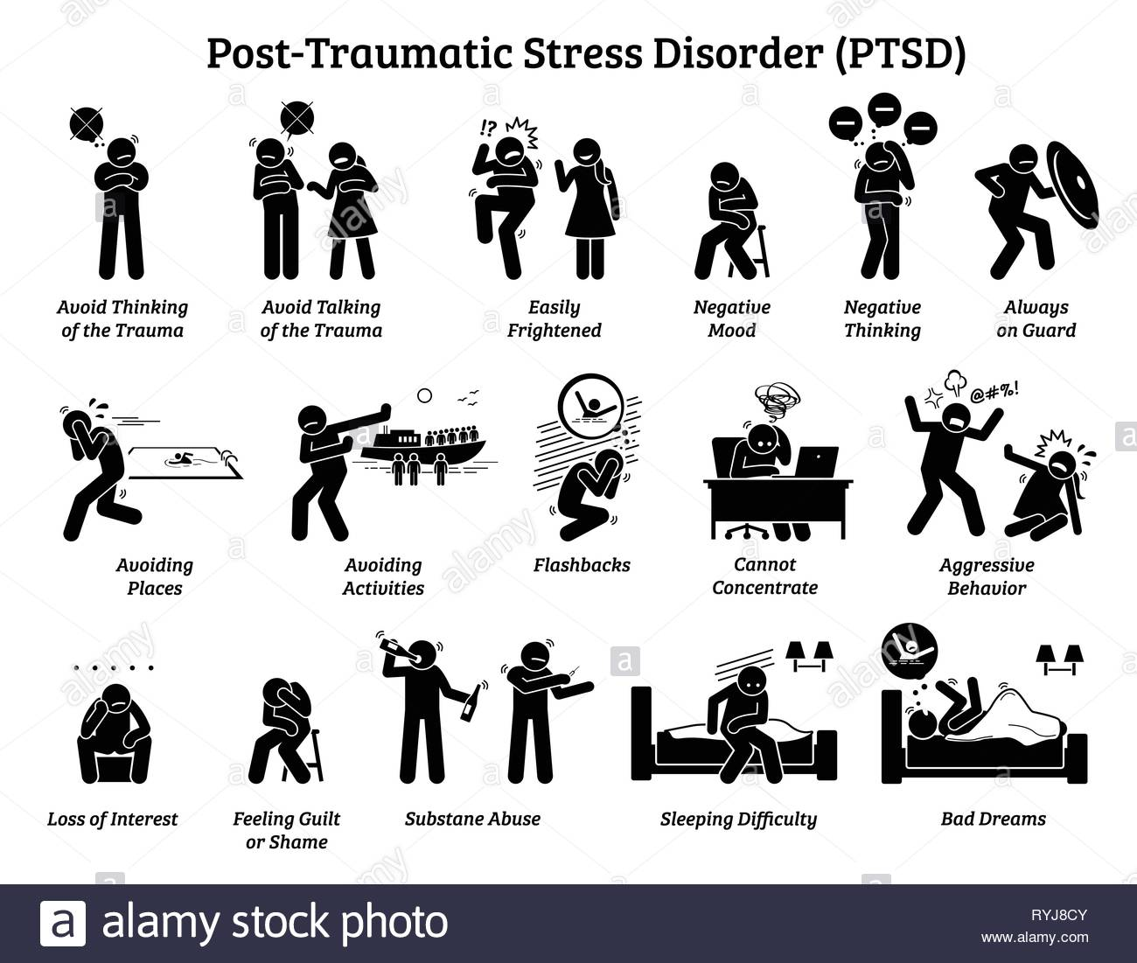
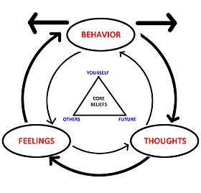
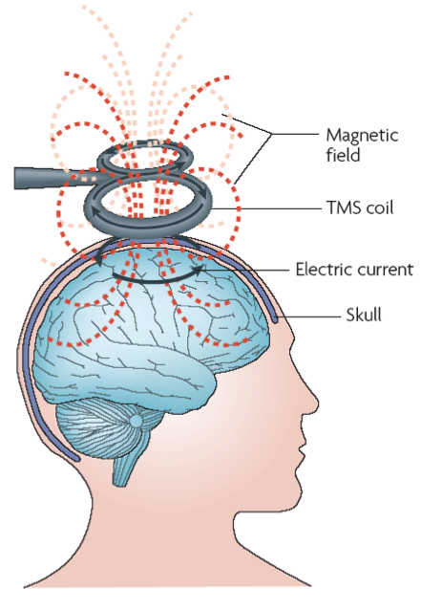
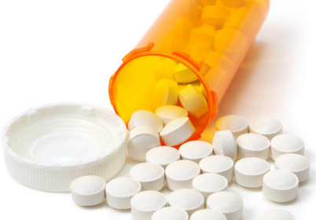
Disorders
Current treatment strategies for PTSD
PTSD – Post Traumatic Stress Disorder
Debilitating psychiatric disorder that manifests after experiencing trauma and characterized by re-experiencing the traumatic event, avoidance of reminders of the traumatic event, negative changes in mood and cognition, and hyperarousal
Treatment options:
Cognitive behavioral therapy (CBT) – most effective in acute PTSD (< 1 month)
Cognitive processing therapy (CPT) – re-exposure/cognitive restructuring
Repeated transcranial magnetic stimulation (rTMS) – for comorbidities
Psychopharmacotherapy – drug administration in tandem with therapy
Psychedelics may show promise, but not so much if comorbidities are present
Many individuals are treatment resistant or misdiagnosed, especially when co-morbidities are present
Notes:
PTSD definition from Speer
mTBI definition from Carlson and emedicine.medscape.com
AD definition from Mohamed and Dolek

Slide 3
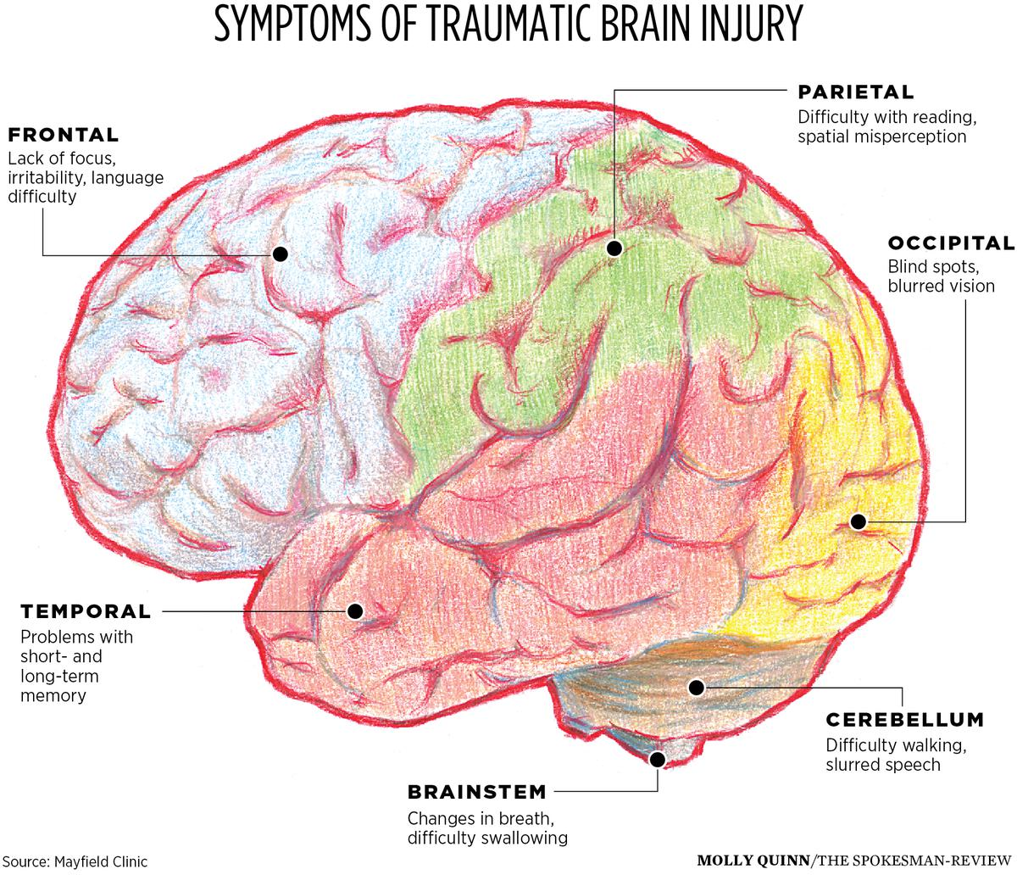
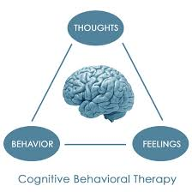
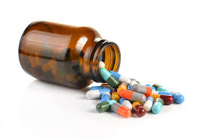
Disorders
mTBI treatment options
Why is mTBI diagnosis so difficult?
TBI treatment options
TBI – Traumatic Brain Injury
A nondegenerative, noncongenital insult to the brain from an external mechanical force, possibly leading to permanent or temporary impairment of cognitive, physical, and psychosocial functions, with an associated diminished or altered state of consciousness; may be mild, moderate, or severe
*mTBI – mild Traumatic Brain Injury
Trauma to the head that results in an alteration/loss of consciousness or post-traumatic amnesia, with symptoms that usually resolve within 2 weeks to 6 months of injury, with a small group continuing to suffer ongoing post-concussive somatic, cognitive, and/or behavioral symptoms/comorbidities similar to PTSD and/or other psychiatric disorders that may lead to long-term functional limitations
TBI is a known risk factor for PTSD
Treatments for psychological symptoms
Cognitive behavioral therapy (CBT) – can help w/ improving attention, executive function, and memory
Repeated transcranial magnetic stimulation (rTMS) – for comorbidities, may be particularly effective if placed above in dlPFC
Psychopharmacotherapy – drug administration in tandem with therapy
Again, many individuals are treatment resistant or misdiagnosed, especially when co-morbidities are present
TBI can be readily detected, but with mTBI, these injuries are physically mild
Mechanically axonal tear and stretching is difficult to detect in a neuroimaging scan as it is very small
Small changes can have large effects that can be exploited using fMRI
Rest/reducing physical and mental activity
Medications
Antianxiety, anticoagulants, anticonvulsants, antidepressants, muscle relaxants, stimulants
Surgery
Removal of clotted blood, skull fracture repair, skull pressure relief
Rehabilitation Therapy
Physical therapy, occupational therapy, speech therapy, psychological counseling, vocational counseling, cognitive therapy
Notes:
TBI may require surgery

Slide 4
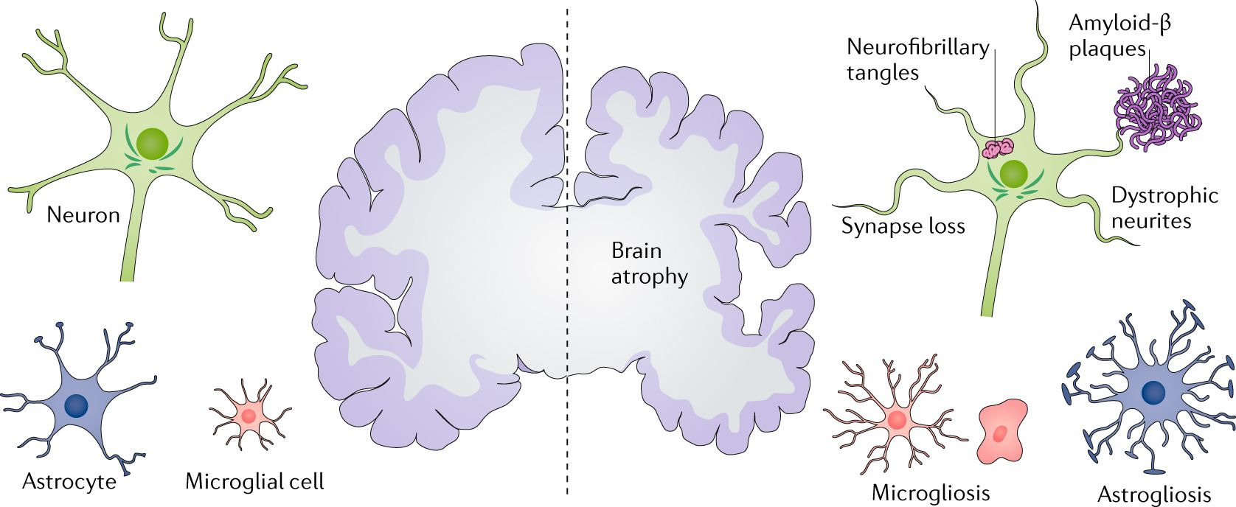
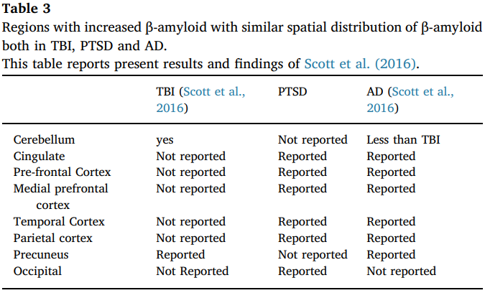
Disorders
AD treatments
AD – Alzheimer’s Disease
Progressive mental deterioration that can occur in middle or old age, characterized by brain pathology consisting of extracellular Aβ plaques, interneuronal tangles of phosphorylated tau protein, synapse and neuronal loss, and decreased hippocampal volume correlated with the degree of cognitive impairment; most common form of dementia
No cure for AD but there are ways to ensure better management of disease
Drugs/Alternative Medicine
Cholinesterase inhibitors, Memantine for mild to moderate, omega-3 fatty acids, curcumin, ginkgo, vitamin E
Creating a safe and supportive environment
always keep valuables in the same place
keep a secure and daily checklist for pharmaceuticals
keep finances on auto-pay/auto-deposit
carry ID and a mobile phone with location and preprogrammed important numbers
keep appointments regular
keep and follow a daily calendar
remove excess clutter and mirrors
install safety rails in stairways and bathrooms
keep photographs and other meaningful objects around the house
wear comfortable shoes with good traction
Exercise and Social Engagement
Acute increases of amyloid precursor protein (APP) have been observed following TBI (few studies have looked at PTSD), and as TBI is a risk factor for PTSD, TBI and/or associated PTSD are thought to be potential risk factors for AD development
Congdon, 2018

Slide 5
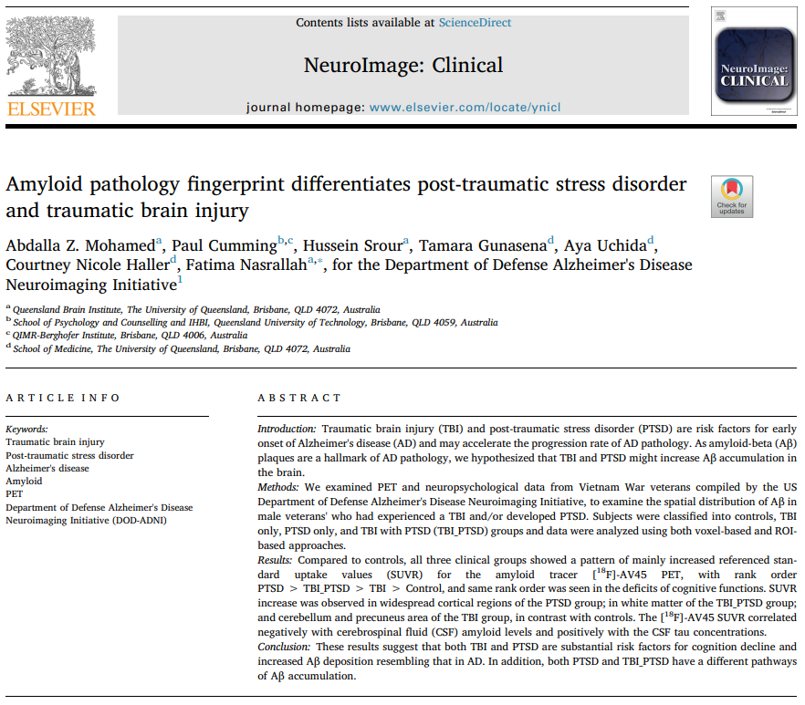
Background #1
Notes:
Previous whole brain imaging analysis has not revealed evidence for amyloidosis, but individual regions of interest (ROI) may reveal differences

Slide 6
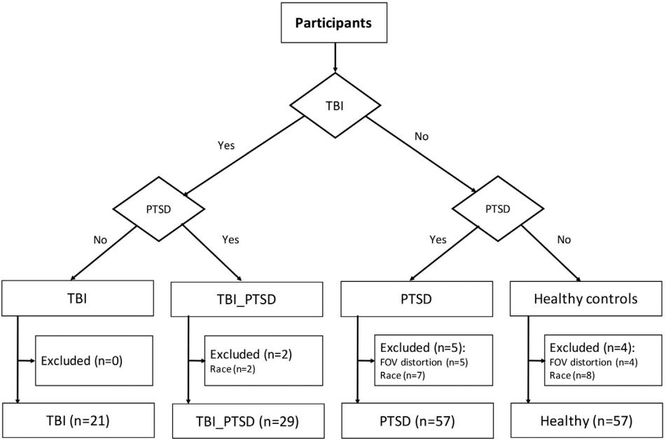
Figure 1
Notes:
190 subjects recruited, 166 used, all from Vietnam War; excludes due to ethnicity-related differences in brain volume and grey matter integrity
PTSD measured with structured Diagnistic and Statistical Manual of Mental Disorders, Fifth Edition (DSM-V) interview and Clinician Administered PTSD Scale (CAPS)
TBI from medical documents detailing moderate-severe non-penetrating TBI

Slide 7
Tests
Assessments:
magnetic resonance imaging (MRI) for structural analysis
amyloid positron emission tomography (PET) scan for functional analysis
using [¹⁸F]-AV45 (Forbetapir) amyloid tracer to compare referenced standard uptake value (SUVR) anatomical maps; amyloid positive if SUVR > 1.1
cognitive and neurological testing (higher scores generally mean worse performance)
Diagnostic and Statistical Manual of Mental Disorders, Fifth Edition (DSM-V)
Clinician Administered PTSD Scale (CAPS)
Montreal Cognitive Assessment (MoCA)
Everyday Cognition (ECog)
Mini-Mental State Exam (MMSE)
Alzheimer’s Disease Assessment Scale-Cognitive (ADAS-Cog)
American National Adult Reading Test (AMEreading)
Clinical Dementia Rating (CDR)
Functional Assessment Questionaire (FAQ)
Combat Exposure Scale (CES)
Geriatric Depression Scale (GDtotal)
biological sampling:
cerebral spinal fluid (CSF)
to determine the levels of tau, phosphorylated-tau at threonine 181 (p-tau₁₈₁), and Aβ42
blood
for genetic analysis
Notes:
Florbetapir is a PET scanning radiopharmaceutical compound containing the radionuclide fluorine-18, FDA approved in 2012 as a diagnostic tool for Alzheimer's disease

Slide 8
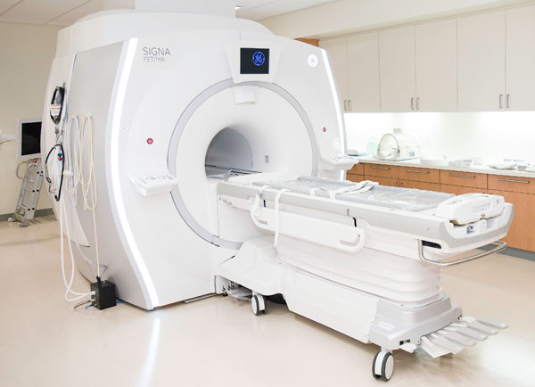
Magnetic Resonance Imaging (MRI)
Medical imaging technique that uses a magnetic field and computer-generated radio waves to create detailed images of the organs and tissues in your body
Uses large, tube-shaped magnets that create a magnetic field that temporarily realign water molecules in the body
Radio waves cause aligned atoms to produce faint signals which are used to create cross sectional brain images that can be 3D stacked like loafs of bread
Non-invasive and with high resolution for structural viewing of the brain
To add a temporal component, functional MRI (fMRI) can be used to see blood flow to areas of the brain and determine which parts of the brain are handling critical functions
Notes:
Definition from https://www.mayoclinic.org/tests-procedures/mri/about/pac-20384768

Slide 9
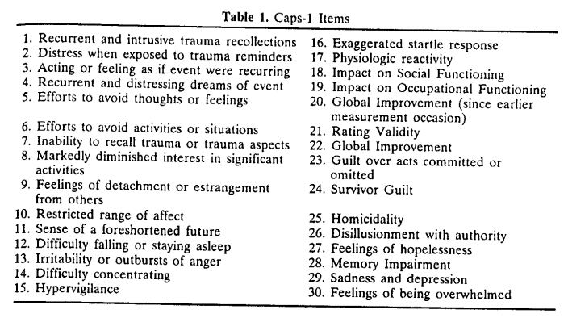
DSM-V and CAPS
The Diagnostic and Statistical Manual of Mental Disorders, Fifth Edition (DSM-V)
Handbook used by health care professionals in the United States and much of the world as the authoritative guide to the diagnosis of mental disorders containing descriptions, symptoms, and other criteria for diagnosis
Clinician-Administered PTSD Scale for DSM-V (CAPS-V)
30-item clinician structured interview in addition to DSM-V that is the gold standard in PTSD assessment
Notes:
CAPS only requires one traumatic event, old DSM-IV required three
CAPS also asks relevant questions to PTSD subtype

Slide 10
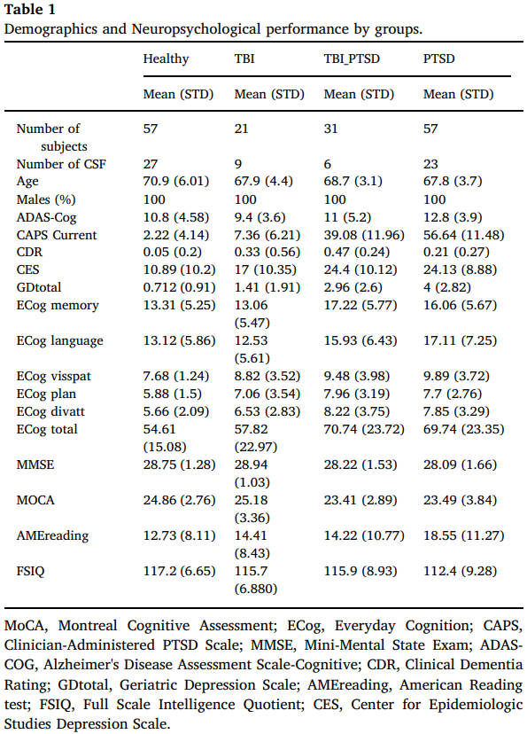
Table 1
n.s.
n.s.
*
*
Notes:
PTSD group with lower IQ and more reading errors not graphically represented by noted here

Slide 11
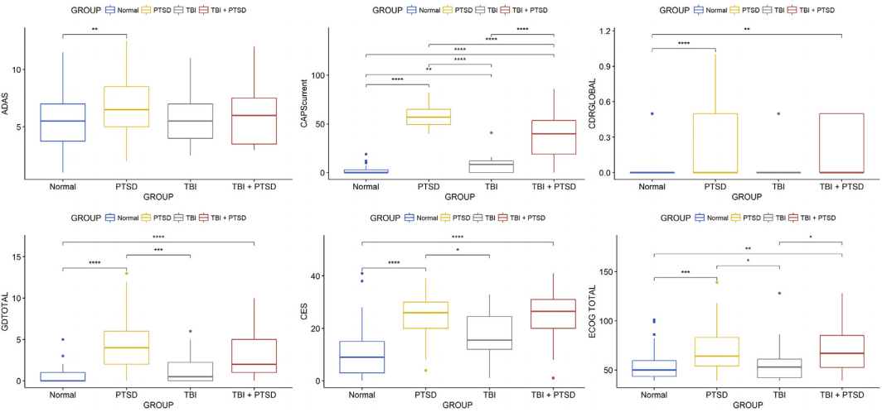
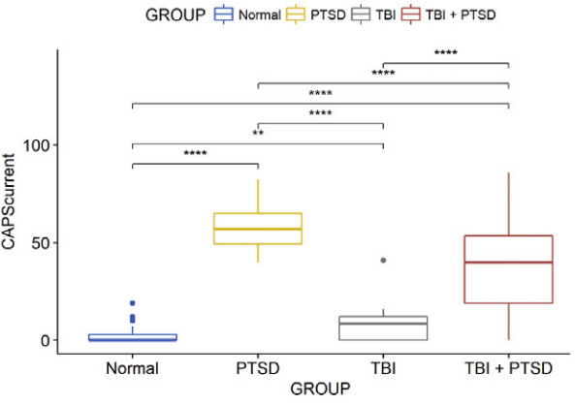
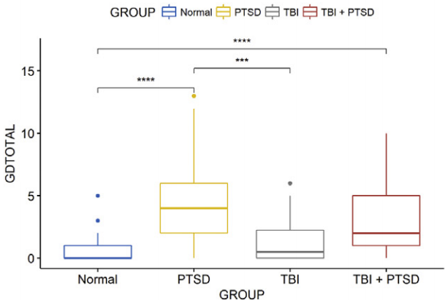
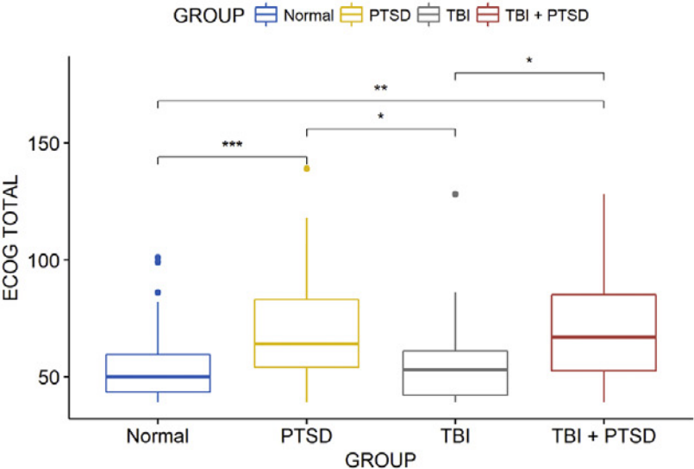
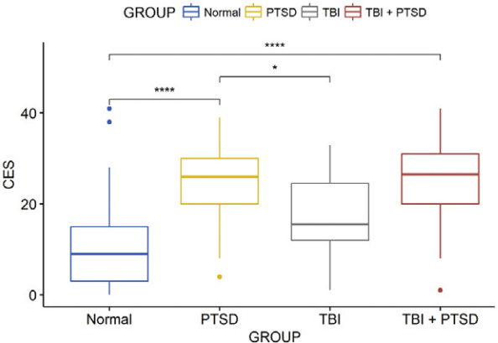
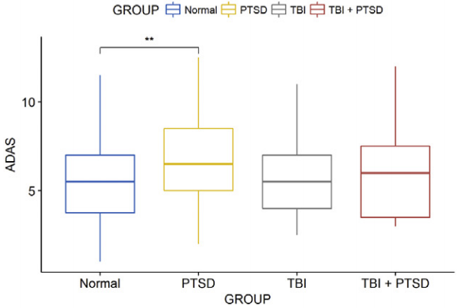
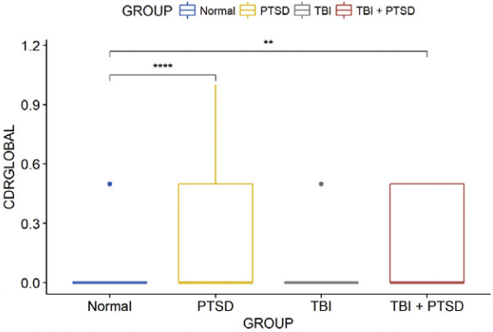
Figure 2
Figure 2
Figure 2
Figure 2
Figure 2
Figure 2
Notes:
Alzheimer’s Disease Assessment Scale-Cognitive (ADAS-Cog) increased in PTSD compared to control (increase = worse performance)
Clinician Administered PTSD Scale (CAPS) higher in PTSD compared to TBI_PTSD, and both groups higher than the control and TBI group (increase = worse performance)
Geriatric Depression Scale (GDtotal) higher for PTSD/TBI_PTSD than controls and PTSD higher than TBI (increase = worse performance)
Combat Exposure Scale (CES) higher in PTSD/TBI_PTSD, but only PTSD had higher than TBI (increase = worse performance)
Clinical Dementia Rating (CDR) higher in PTSD compared to controls, suggesting cognitive deficits more pronounced in both PTSD groups than in the TBI alone or control group (increase = worse performance)
Everyday Cognition (ECog) higher for PTSD/TBI_PTSD compared to controls and TBI groups; PTSD showed worse visuospatial ability and PTSD/TBI_PTSD showed worse memory ability, planning, and divided attention in contrast to controls (increase = worse performance)

Slide 12
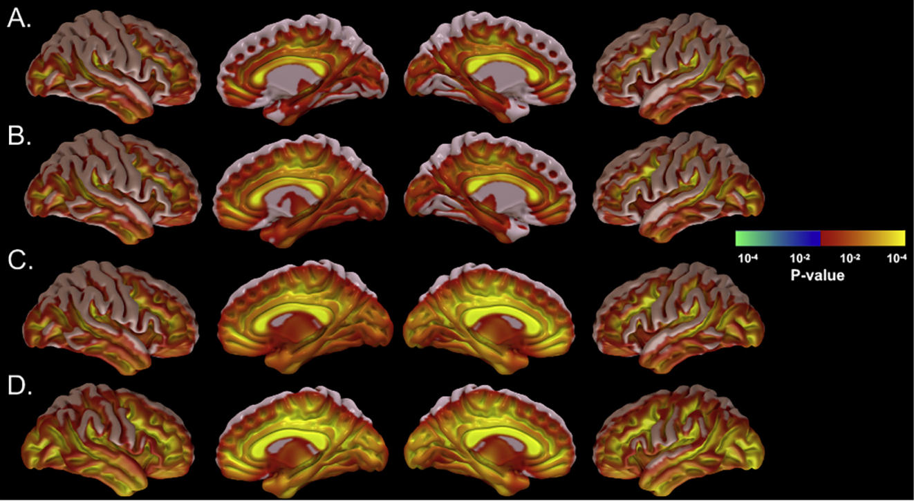
Figure 3
Control
TBI
Significantly less activity
Significantly more activity
TBI_PTSD
PTSD
Notes:
Regions with significantly elevated [18F]-AV45 referenced standard uptake values (SUVR >1.1); red to yellow = significant increase, blue to green = significant decrease *more yellow = lower p value, most yellow in TBI_PTSD and PTSD groups
TBI_PTSD group increased SUVR in white matter
PTSD group increased SUVR globally

Slide 13
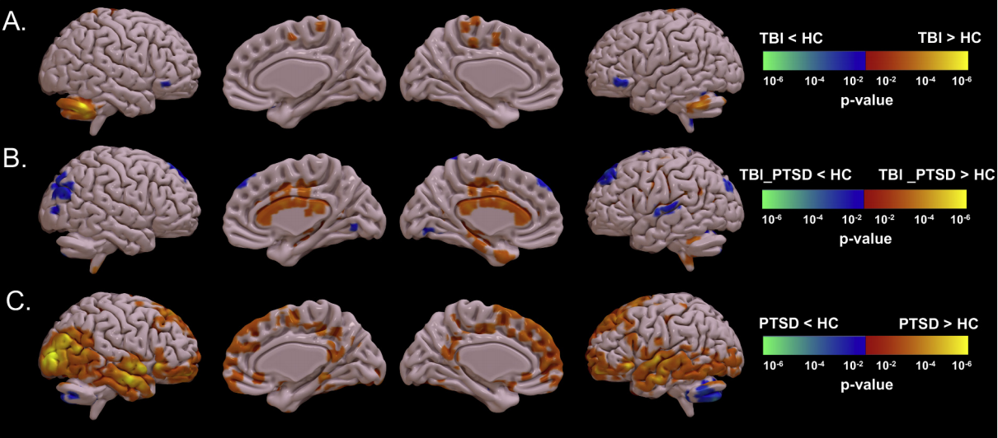
Figure 4
Significantly less activity
Significantly more activity
Significantly less activity
Significantly more activity
Notes:
Contrast of [¹⁸F]-AV45 between healthy and clinical groups
TBI vs HC see higher SUVR in cerebellar tonsil and precuneus and lower SUVR in vlPFC
TBI_PTSD vs HC see higher SUVR in white matter, especially corpus callosum, cingulate cortex, middle temporal gyrus and lower SUVR in middle frontal gyrus, superior temporal gyrus, and inferior parietal cortex
PTSD vs HC see higher SUVR in cortical areas such as PFC, orbital gyrus, superior, middle, and inferior temporal gyrus, hippocampus, middle and inferior occipital gyrus, posterior cingulate gyrus, and supplementary motor area

Slide 14
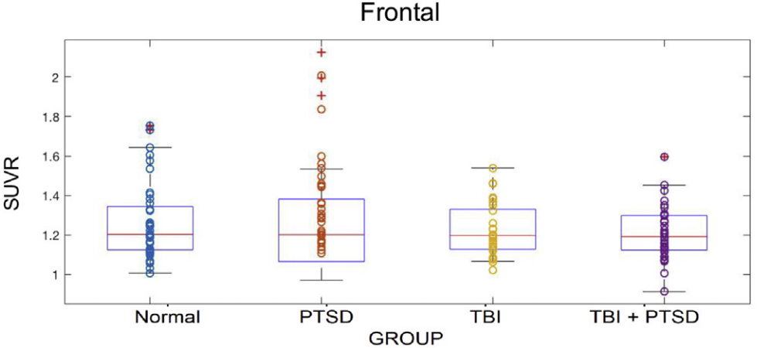
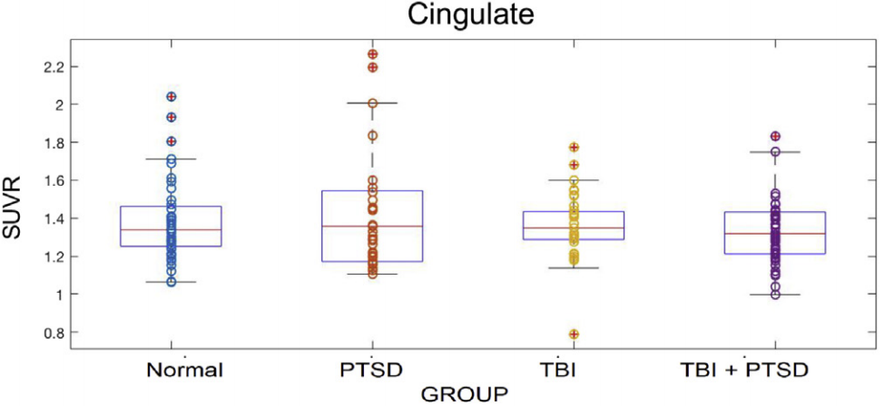
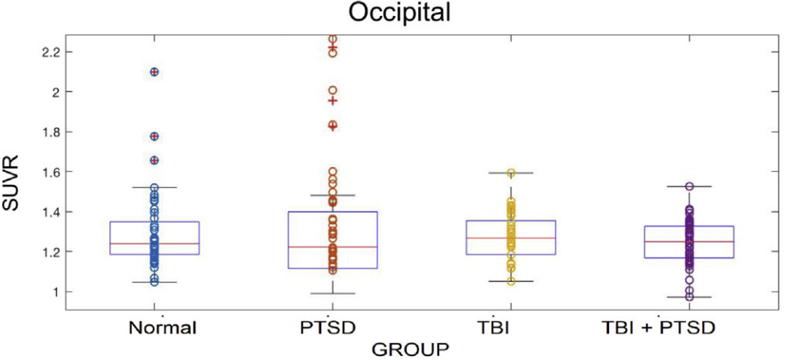
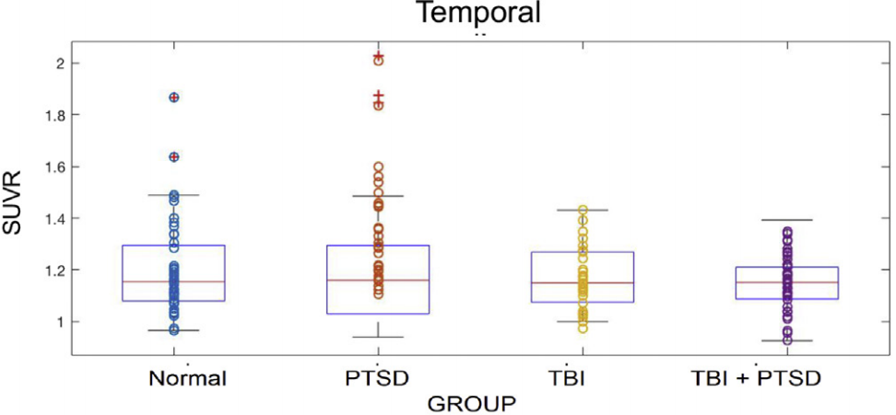
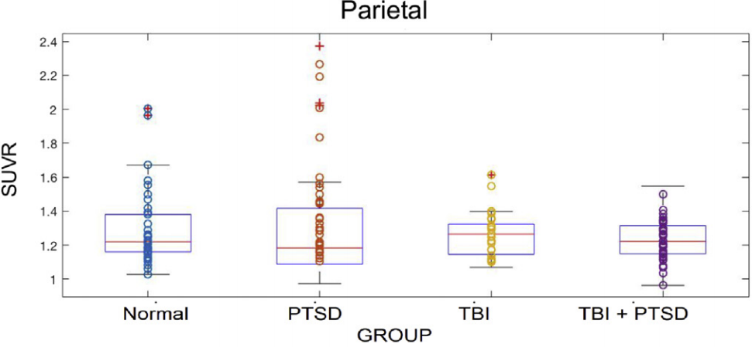
Figure 5
Figure 5
Figure 5
Figure 5
Figure 5
Notes:
SUVR for 5 brain regions; PTSD increased in all 5 VOI i.e. frontal, parietal, occipital, cingulate, and temporal
PTSD higher compared to controls in all, not much else is discussed here in text…

Slide 15
Table 2
Notes:
CSF Aβ and Tau levels correlated with Aβ levels in the brain in TBI alone group; regional correlations between CSF Aβ and tau in HC and TBI_PTSD group; no correlation in PTSD alone group
Unfortunately, real values for these biological serum levels are not given, only their correlations to levels in brain regions

Slide 16
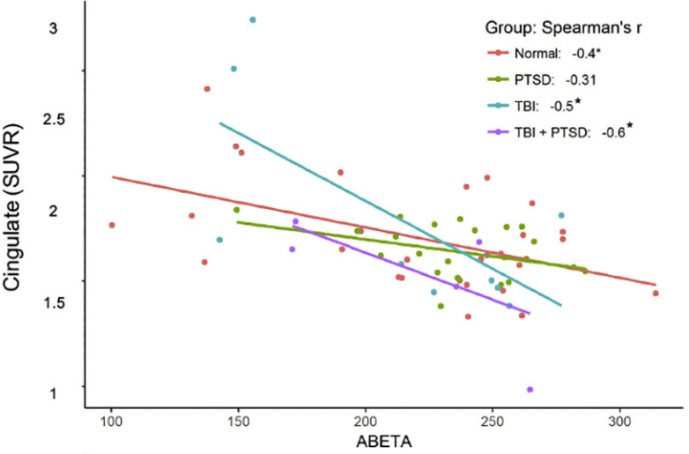
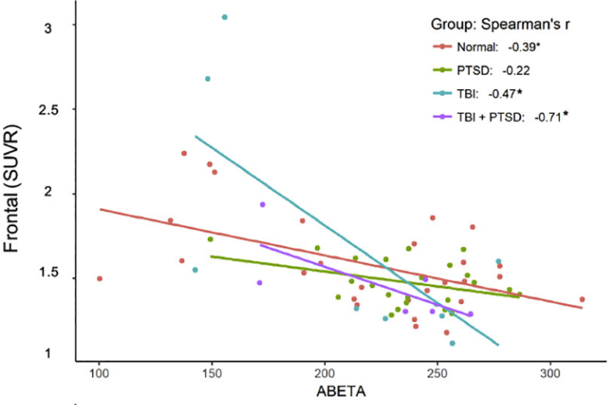
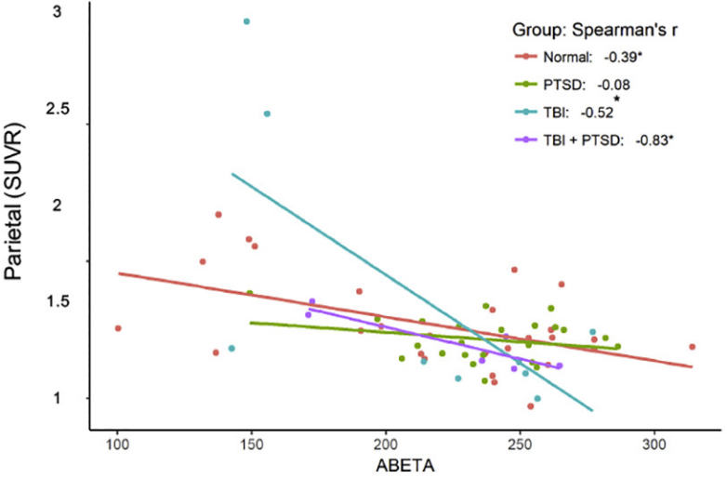
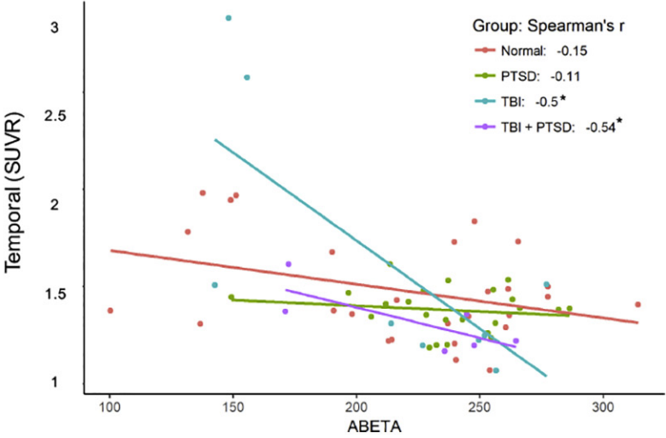
Figure 6
Figure 6
Figure 6
Figure 6
Notes:
Negative correlation between [¹⁸F]-AV45 and CSF Aβ concentrations in:
HC frontal, parietal, and cingulate cortices
TBI frontal, parietal, cingulate, and temporal cortices
TBI_PTSD frontal, parietal, cingulate, and temporal cortices
PTSD no correlations

Slide 17
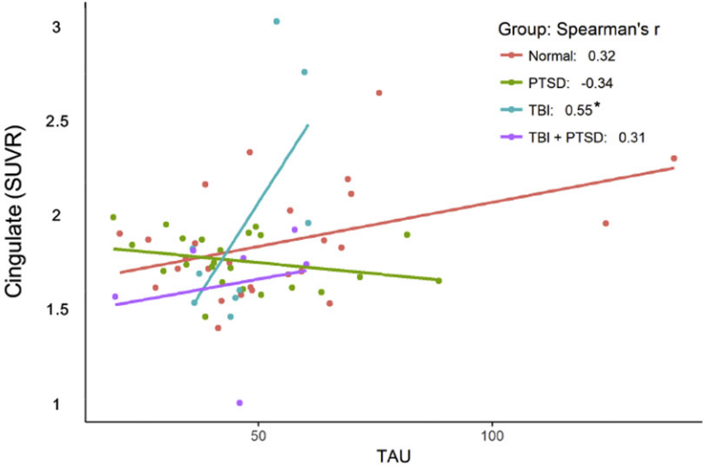
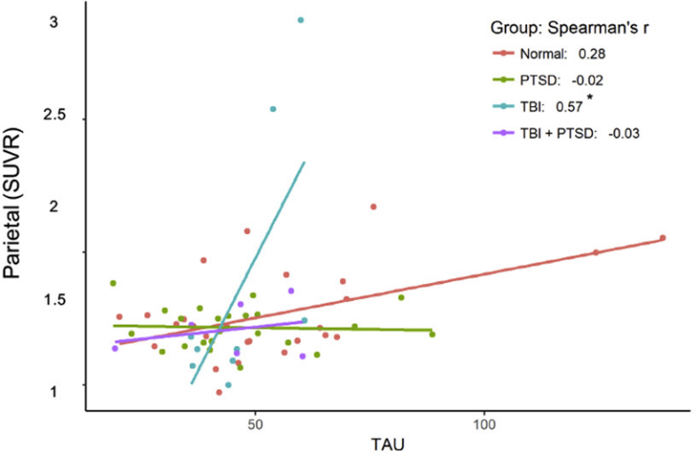
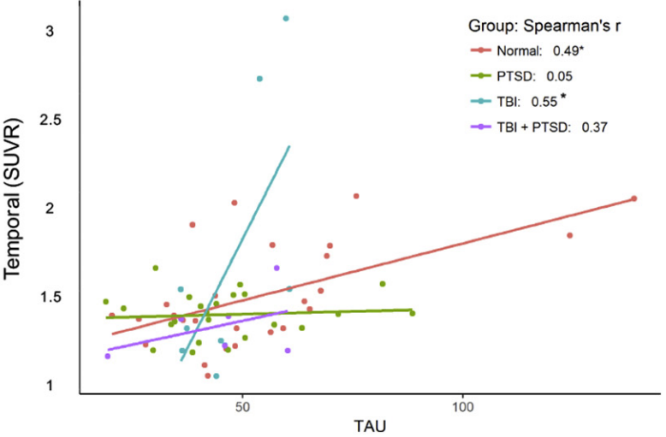
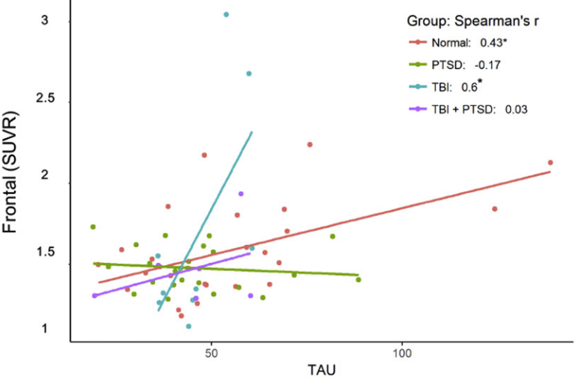
Figure 7
Figure 7
Figure 7
Figure 7
Notes:
Positive correlation between [¹⁸F]-AV45 and CSF tau concentrations in:
HC frontal and temporal cortices
TBI frontal, cingulate, parietal, and temporal cortices

Slide 18
Conclusion
Increased SUVR (standard reuptake values) for amyloid tracer [¹⁸F]-AV45 (Forbetapir) as well as deficits in cognitive function, both with rank order PTSD>TBI_PTSD>TBI>Control
Forbetapir tracer accumulation correlates negatively with CSF amyloid levels and positively with CSF tau concentrations
Widespread in PTSD, concentrated to white matter of TBI_PTSD, and in the cerebellum and precuneus area of TBI group compared to controls
This suggests both TBI and PTSD are substantial risk factors for cognition decline and increased Aβ deposition resembling AD in a subset of the population
However, each disorder has its own pathway for Aβ accumulation
PTSD, TBI, and AD are all highly associated with increased neuro-inflammatory mediators, including cytokines, chemokines, and other neurotoxic mediators such as tryptase, histamine, IL-1β, TNF-α, IL-6, CCL2, IL-8, ROS, CRH, and MMPs, any of which might contribute to neurodegeneration and β-amyloid accumulation.
Preinjury functioning and socioeconomic status should also be considered
Notes:
Florbetapir is a PET scanning radiopharmaceutical compound containing the radionuclide fluorine-18, FDA approved in 2012 as a diagnostic tool for Alzheimer's disease
Tau in CSF is also a clinical marker for AD, so this matches up

Slide 19
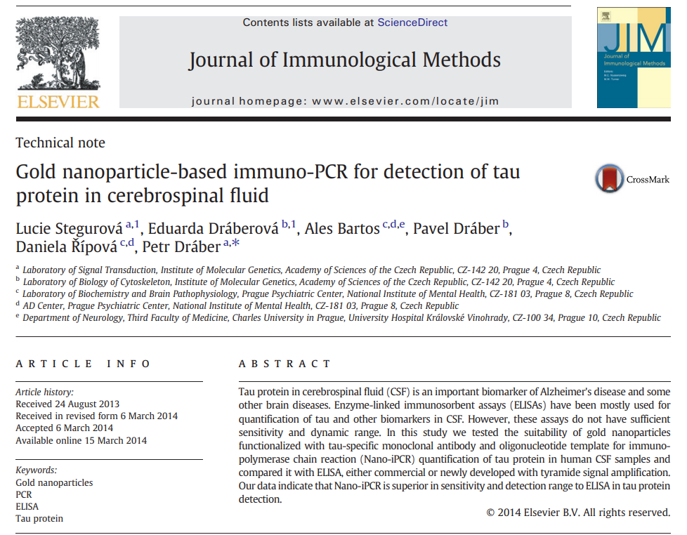
Background #2
Notes:
Tau levels in CSF can be used as a biomarker for neuronal and axonal degeneration (as seen in Creutzfeldt-Jacob disease), with enhanced CSF levels of total- and p-tau and decreased levels of Aβ in AD
This is generally done using ELISA (enzyme-linked immunoabsorbent assays), but these are expensive and don’t have a dynamic range (can’t show extremely low or high levels of tau)

Slide 20
Background
Tau levels in CSF can be used as a biomarker for neuronal and axonal degeneration (as seen in Creutzfeldt-Jacob disease), with enhanced CSF levels of total- and p-tau and decreased levels of Aβ in AD
Generally done using ELISA (enzyme-linked immunosorbent assays), but these are expensive and don’t have a dynamic range (can’t show extremely low or high levels of tau)
Nano-iPCR [immuno-polymerase chain reaction using gold nanoparticles (Au-NPs)] has been shown to be superior in detection of cytokines and viral proteins compared to standard ELISA, which is further confirmed here

Slide 21
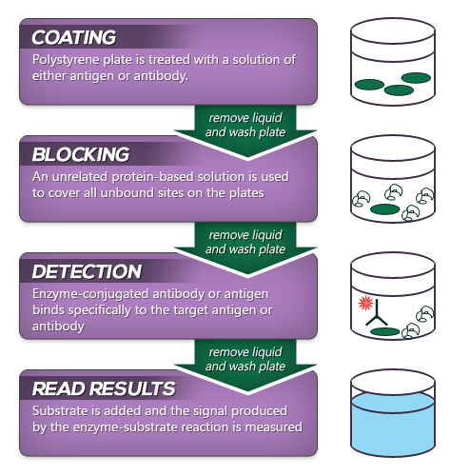
ELISA (enzyme-linked immunosorbent assay)
Assay in which a molecule is adsorbed on to a solid surface, usually a microplate well, then complexed with an antibody (Ab) linked to an enzyme, using light absorption properties for molecular enzymatic immunodetection
Notes:
From https://www.bosterbio.com/protocol-and-troubleshooting/elisa-principle

Slide 22
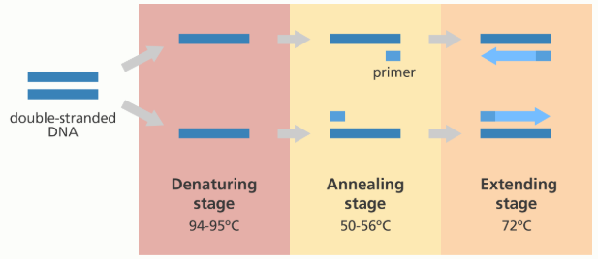
PCR (polymerase chain reaction)
Technique which is used to amplify the amount of a specific segment of DNA through a series of heating and cooling done in 3 main steps (denaturing, annealing, extending) repeated 20-40x
Only a very small amount of starting material is needed to preform this
Notes:
From https://www.yourgenome.org/facts/what-is-pcr-polymerase-chain-reaction

Slide 23
iPCR (immuno-polymerase chain reaction)
Best of both worlds!
Combines ELISA protein detection and PCR signal amplification for a more sensitive antigen detection by replacing detection antibody with an antibody-oligonucleotide conjugate
Here, the authors combine PCR with sandwich ELISA where target antigen is immobilized by Abs to the PCR plate wells and then detected by iPCR using gold nanoparticles (Au-NPs) functionalized with both antigen-specific Ab and PCR oligonucleotide template

Slide 24
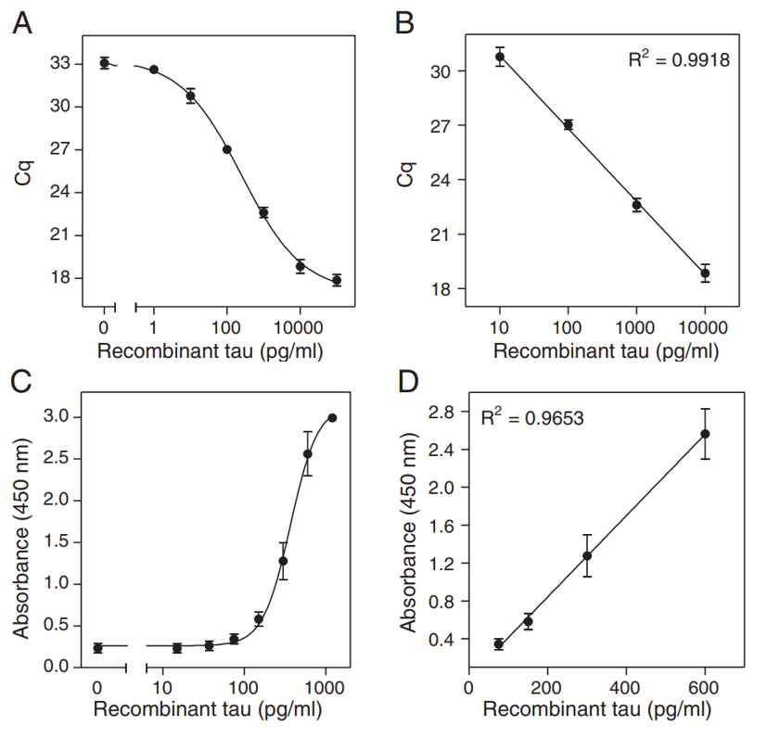
Figure 1
PCR
ELISA
Notes:
C_{q} = The cycle in which fluorescence can be detected is termed quantitation cycle with values of 17.9 to 32.6; lower C_{q} means higher initial copy numbers of the target
R² regression correlation coefficient of .9918 from 10 to 10,000 pg/ml; LOD (limit of detection) is 5 pg/ml
C) Absorbance values of 0-1200 pg/ml
D) R² regression correlation coefficient .9653 in range 75-600 pg/ml; LOD (limit of detection) at 140 pg/ml
D)

Slide 25
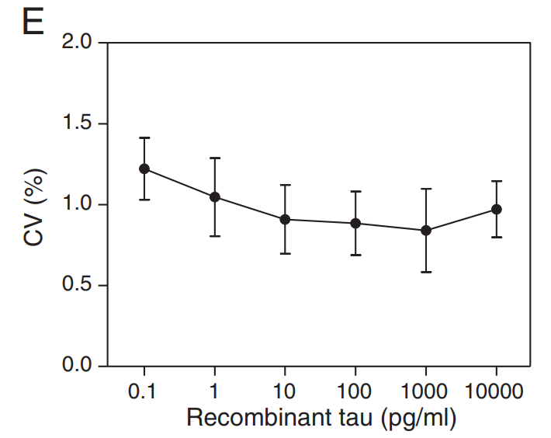
Figure 1
Precision profile showing broad range of Nano-iPCR
Notes:
CV = coefficient of variation;

Slide 26
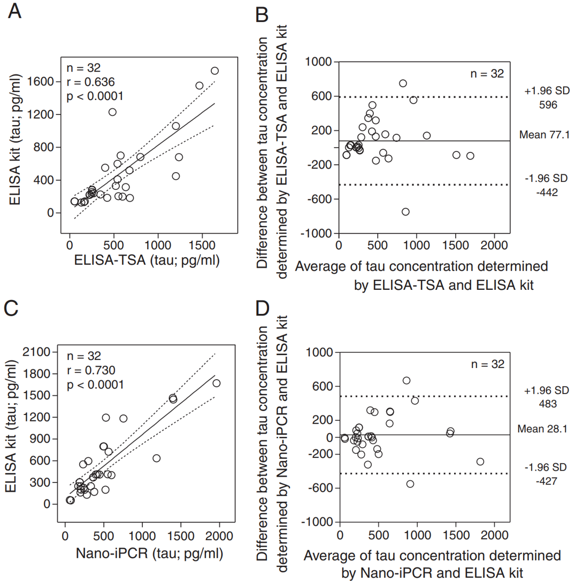
ELISA-TSA and ELISA
Figure 2
Nano-iPCR and ELISA
Notes:
Shows each is similar but not the same (B) and (D) differences between 2 techniques plotted against average of each technique; (A) and (C) show correlation between each technique
Correlation plot for ELISA-TSA = Tyramide Signal Amplification (to increase sensitivity)
Bland-Altman plot (average tau concentration from ELISA-TSA and ELISA, solid line mean difference dashed lines 95% CI)
Correlation plot for Nano-iPCR
Bland-Altman plot (average tau concentration from Nano-iPCR and ELISA, solid line mean difference dashed lines 95% CI)

Slide 27
Conclusion
Nano-iPCR using Au-NPs functionalized with anti-tau MAb and template oligonucleotide is fully suitable for rtPCR detection of tau protein
Not only is it suitable, it is superior to traditional ELISA and ELISA-TSA due to increased sensitivity and range of tau detection as well as decreased cost to run
Notes:
MAb = monoclonal antibodies

Slide 28
Background Conclusion
TBI and PTSD are substantial risk factors for cognitive decline and increased Aβ deposition resembling AD in a subset of the population
Neuroimaging can reveal amyloid differences between PTSD, TBI_PTSD, and TBI groups
Au-NPs can be used in iPCR to target tau in vitro better than ELISA
Perhaps iPCR could be a useful technique to distinguish PTSD from mTBI patients as well? Or use of NPs in neuroimaging for tau or other biomolecule detection to help with this distinction?
Since NPs can be used to target in vitro, could we use in vivo NP targeted treatment for neurodegeneration and/or cognitive decline that is seen in PTSD, (m)TBI, and AD?

Slide 29
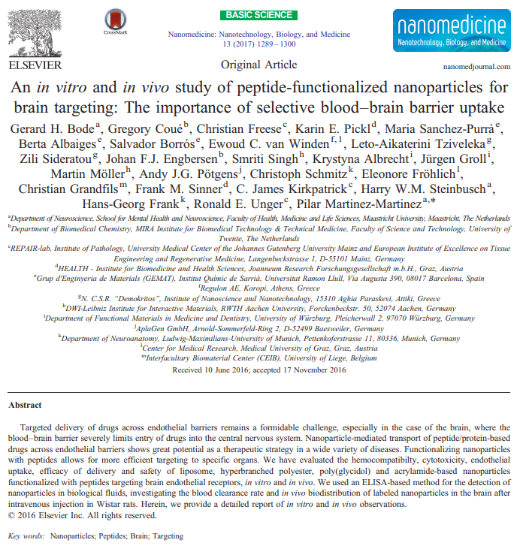
Topic Paper
Notes:
Targeted delivery of drugs across endothelial barriers (esp. BBB) is a challenge, but potentially therapeutic for a number of diseases. Herethe authors evaluate hemocompatibility, cytotoxcicity, endothelial uptake, efficacy of delivery, and safety of: liposome, hyperbranched polyester, poly(glycol), and acrylamide-based nanoparticles functionalized w/ peptides targeting endothelial receptors in vivo and in vitro, detected using ELISA

Slide 30
Nanoparticles (NPs)
Loaded with enzyme degradation protected peptides and proteins that help facilitate transfer across biological membranes for targeted drug delivery
Brain endothelial cell receptors such as LDLs, transferrin, and insulin receptors can be specifically targeted by coating NPs with peptides that bind to these receptors on the target tissue allowing for peptide-nanoparticle complex uptake via receptor-mediated endocytosis
Liposomes, dendritic polymers (symmetric dendrimeric and non-symmetric hyperbranched polymers), polymeric nanospheres, and nanogels are main types of organic NPs discussed here

Slide 31
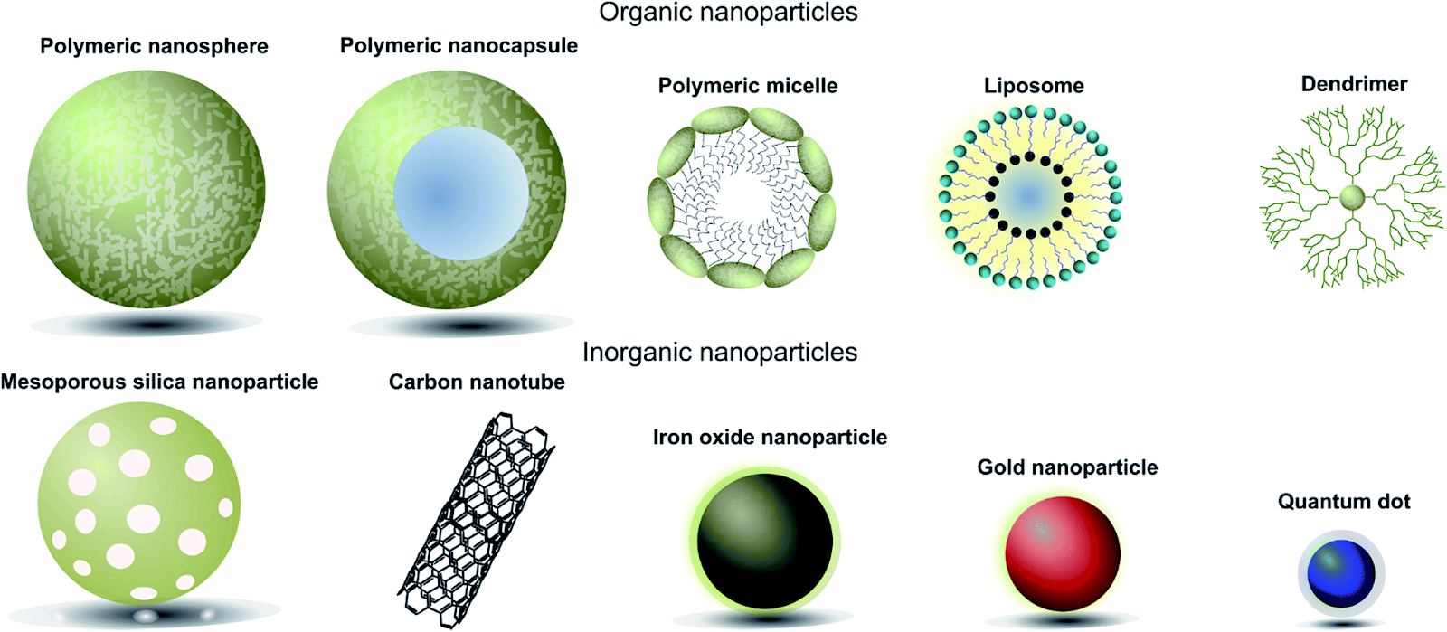

Slide 32
Liposomes
Small, artificial vesicles of spherical shape which consist of an aqueous core entrapped by one or more bilayers composed of natural or synthetic, biocompatible, and biodegradable lipids similar to biological membranes
Biophysical properties of liposomes such as size, surface charge, lipid composition and amount of cholesterol are variable and able to control distribution, tissue uptake, and drug delivery
Usually rapidly cleared from the blood following IV administration
Surface can be modified with PEG (polyethylene glycol) and other molecules to alter pharmacokinetics and biological distribution of NPs
Notes:
Cleared from blood w/i 5 mins in rats

Slide 33
Dendritic Polymers
Nanometer-sized, highly branched macromolecules which consist of a central core, branching units, and terminal functional groups useful in drug delivery systems
Major structural features:
existence of nanocavities, which can encapsulate various bioactive compounds
ability for the accumulation of a significant number of functional groups on their external surface that can induce intense binding to multiple cell receptors

Slide 34
Nanospheres
Sub-micron-sized highly soluble colloidal structures composed of synthetic and semi-synthetic polymers that vary in size from 1 to 1000 nm in which a drug can be dissolved or encapsulated
Usually rapidly cleared from the blood following intravenous administration; however the use of biodegradable materials for nanosphere preparation allows for sustained drug release at the targeted site
More stable in biological fluids compared with other colloidal carriers
Surface can be modified with PEG and other molecules to alter pharmacokinetics and biological distribution of NPs
Notes:
Cleared from blood w/i 5 mins in rats
Colloid = a homogeneous noncrystalline substance consisting of large molecules or ultramicroscopic particles of one substance dispersed through a second substance. Colloids include gels, sols, and emulsions; the particles do not settle, and cannot be separated out by ordinary filtering or centrifuging like those in a suspension

Slide 35
Nanogels
Nanogel
Hydrophilic polymers cross-linked in porous networks capable of retaining water-soluble therapeutical peptides and proteins
Usually range from 10-400 nm
small enough to avoid clearance of the reticuloendothelial system
large enough to avoid clearance from circulation by glomerular filtration in kidneys
Can be designed for stimulus-responsive degradation and drug release, and they have also been investigated as vehicles for drug delivery to the brain

Slide 36
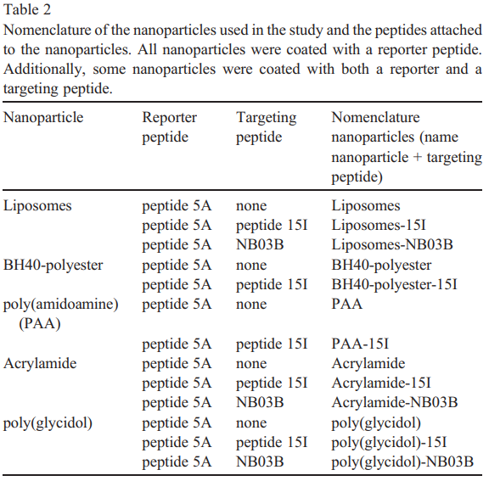
Tables 1 and 2 peptide and nanoparticle nomenclature, respectively
Liposomes
Dendritic Polymers
Nanospheres
Nanogel
Reporter peptide
Target LDL brain receptors
Target brain endothelial cells
Notes:
5 NP classes used w attached reported peptide 5A (mostly synthesized, containing carboxyfluorescein and a biotin group allowing for ELISA detection) and occasional brain targeting peptide angiopep sequence (peptide 15I) (Angiopep peptides target LDL receptors and result in receptor mediated transcytosis) or Semliki forest virus (SFV) based protein NB03B (SFV is a neuroinvasive virus thought to be able to cross the BBB)
BH40-polyester and poly(aminoamide)(PAA) are dendrimers, acrylamide and poly(glycidol) are nanogels

Slide 37
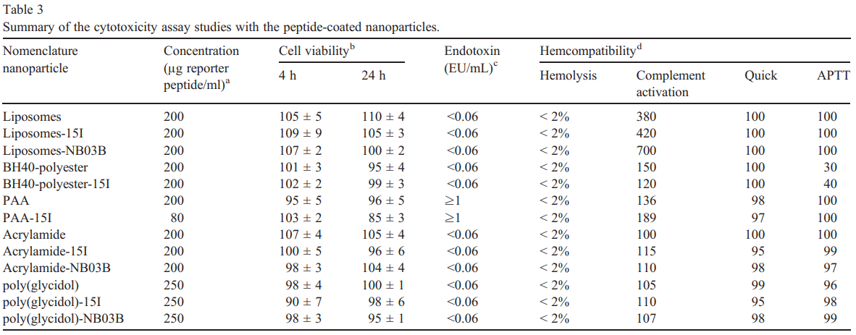
Table 3
Potential cytotoxic effects (such as embolization, hemolysis, cellular activation, and biological cascades such as coagulation, complement activation, kinin/kininogen, fibrinolysis) can occur and must be tested in vitro before administration
Notes:
NPs from 2 tested for presence of endotoxin contamination (<.06 is okay, >1 is thrown out for in vivo) and potential cytotoxic effects (such as embolization, hemolysis, cellular activation, coagulation, complement activation, kinin/kininogen, fibrinolysis) in vitro (all tested okay without any sever adverse reactions) using HELA cell line EAhy926 endothelial cells, with no changes seen in cell viability tested at 4 and 24 hrs

Slide 38
Figure 1
Notes:
Human cerebral microvascular endothelial cell line hMCEC/D3 with reporter peptide 5A and brain targeting peptide 15I or NB03B
Cell nuclei stained with Hoechst dye in blue, reported peptide 5A in green
Arrows show cells with NP uptake, seen in all cells

Slide 39
Figure 1
Notes:
Human cerebral microvascular endothelial cell line hMCEC/D3 with reporter peptide 5A and brain targeting peptides 15I or NB03B
Cell nuclei stained with Hoechst dye in blue, cell membranes stained with anti-CD31 in red, reporter peptide 5A in green
Arrows show cells with NP uptake, seen in all cells

Slide 40
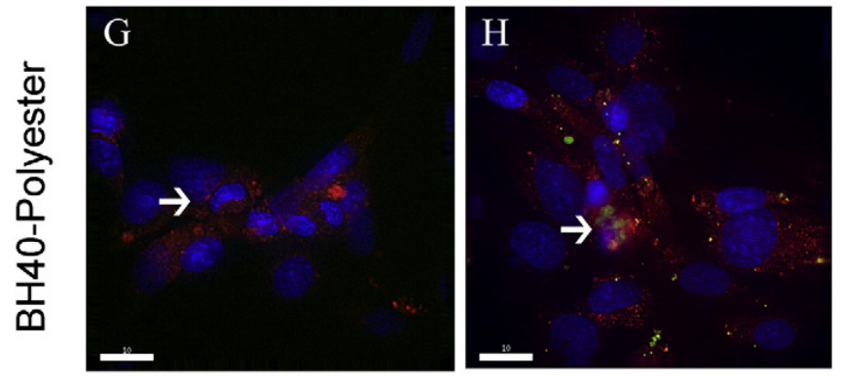
Figure 1
Notes:
Human cerebral microvascular endothelial cell line hMCEC/D3 with reporter peptide 5A and brain targeting peptide 15I
Cell nuclei stained with Hoechst dye in blue, cell membranes stained with anti-CD31 in red (H)
Arrows show cells with NP uptake, seen in all cells

Slide 41
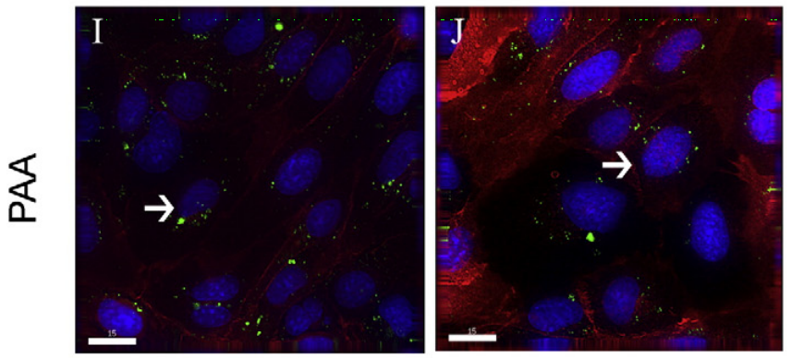
Figure 1
Notes:
Human cerebral microvascular endothelial cell line hMCEC/D3 with reporter peptide 5A and brain targeting peptide 15I
Cell nuclei stained with Hoechst dye in blue, cell membranes stained with anti-CD31 in red (I)
Arrows show cells with NP uptake, seen in all cells

Slide 42
Figure 1
Notes:
Human cerebral microvascular endothelial cell line hMCEC/D3 with reporter peptide Rhodamine (K-L) or 5A (M) and brain targeting peptide 151 or NB03B, uptake only observed in targeted cells
Cell nuclei stained with Hoechst dye in blue, reported peptide 5A in green
Arrows show cells with NP uptake, seen in target peptide 15I and REGNBO3B cells (L-M), but no NP uptake observed in untargeted cells (K)

Slide 43
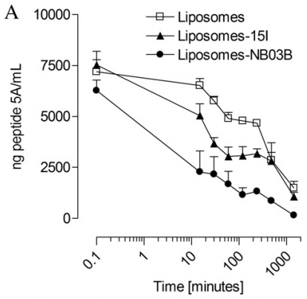
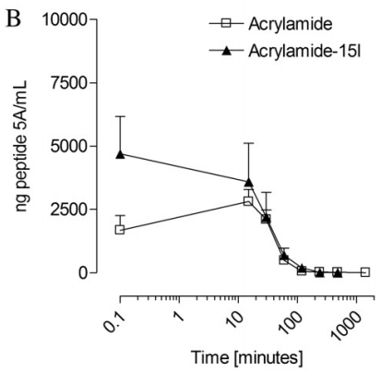
Figure 2
Notes:
Blood plasma concentration of 5A reporter peptide to evaluate NP blood clearance rate in Winstar rats
Liposomes detected in blood up to 24 hrs after injection, however a rapid reduction of 5A plasma concentration in 15I and NB03B by 36 and 64%, respectively, 30 mins after injection
Acrylamide detected in blood up to 2 hrs after injection
BH40-Polyester detected in blood up to 2 hrs after injection, when 15I is attached faster elimination from circulation possibly due to increased uptake
No effect of targeting peptide observed in PAA NPs as well as nanogels (not shown, but in supplementary figure)
Supplementary figures also show same 2 hr retention for poly(glycidol) nanogels and PAA

Slide 44
Figure 3
Figure 3
Figure 3
Figure 3
Figure 3
Notes:
Concentration of 5A reporter peptide in various brain regions at various times following injection of NPs and measured with ELISA, amounts all below 10 ng per gram of tissue
When 15I or NB03B (difficult to see in graph…) are anchored to liposomes, concentration of 5A increases over time
Addition of either targeting peptide to acrylamide NPs does not result in difference in 5A concentrations in brain compared to non-targeted
Lower 5A concentrations w 15I observed at 2 hrs, 4 hrs, and 24 hrs for BH40 NPs
No difference in 5A concentration observed between PAA NPs w and w/o 15I targeting protein
Lower 5A concentrations w NB03B observed at 2 hrs, 4 hrs, and 24 hrs for poly(glycidol) NPs

Slide 45
Figure 4
Figure 4
Figure 4
Figure 4
Figure 4
Notes:
Concentration of peptide 5A in liver homogenate after IV injection of NPs
Highest concentration seen in animals injected with liposomes compared to all other NP compositions; 15I targeted liposome saw highest concentration after 24 hrs; NB30B not measured at 1440 mins
NB30B targeted acrylamide NPs result in higher liver uptake at 15 mins, 2 hrs, and 4 hrs
N.s. difference in liver uptake between non-targeted and targeted BH40-Polyester dendritic polymer; low PH40-Polyester accumulation in liver due to NP hydrophilic nature
N.s. difference in liver uptake between non-targeted and targeted PAA dendritic polymer
N.s. difference in liver uptake between non-targeted and targeted poly(glycidol) nanogel; low poly(glycidol) accumulation in liver due to NP hydrophilic nature

Slide 46
Figure 5
Figure 5
Figure 5
Figure 5
Notes:
Concentration of peptide 5A in CSF after IV injection of NPs
Peptide 5A detectible if CSF of liposome injected animals for up to 24 hrs
Increasing 5A CSF concentrations w NB03B observed at 2 and 4 hrs for poly(glycidol) NPs, increasing 5A CSF concentrations w 15I observed at 2 hrs then maybe decreased slightly at 4 hrs
Lower 5A CSF concentrations w 15I observed at 2 hrs, 4 hrs, and 24 hrs for BH40 NPs
No difference in 5A CSF concentration observed between PAA NPs w and w/o 15I targeting protein

Slide 47
Figure 6
Notes:
Immunohistochemical analysis of unperfused brain and liver tissue obtained from rats injected with peptide 5A/NB03B loaded liposomes revealed the presence of peptide 5A in the choroid plexus and surrounding blood vessel-like structures in animals sacrificed without transcardial perfusion; in contrast 5A was undetectable in the brains of animals that were transcardially perfused (data not shown)
A, D) The strongest staining in the brain (A) and liver (D) was observed 15 minutes after injection
B, E) Weaker staining in brain (B) and liver (E) 2 hours after injection
C, F) Almost undetectable levels in brain (C) and liver (E) 24 hours after injection

Slide 48
Figure 7
Green channel: FITC labeled peptide 5A
Red channel: Astrocyte marker GFAP
Blue channel: Nucleus (Hoechst)
50 μm
Notes:
Immunohistochemical analysis of unperfused brain and liver tissue obtained from rats injected with peptide 5A/NB03B loaded liposomes revealed the presence of peptide 5A in the choroid plexus and surrounding blood vessel-like structures

Slide 49
Conclusion
NPs functionalized with targeting peptides for specific brain delivery can be used in drug treatment
Must think about both the ability to carry peptide/cargo and biodegradable nature when constructing NPs
Also consider NP safety by pre-screening in vitro cytotoxicity and hemocompatibility to avoid severe adverse effects in vivo
Uptake method by endothelial cells must also be considered
Both targeted and non-targeted NPs were taken in by cells, suggesting intake might not be via internalization through a receptor-mediated pathway (except in nanogels) but perhaps through a clathrin- and caveolin-1 independent path

Slide 50
Conclusion
Here, no preferential uptake of NPs in brain tissue could be detected
Low amount of NPs detected in brain may be due to combinations of NPs and targeting peptides not showing enough specificity for brain endothelial cells, or due to the low solubility of the NP-peptide complex causing quicker enzymatic degradation of targeting peptide and/or reporter label
Liposomal NPs reach the brain better when unperfused
The liver plays a role in liposomal NP clearance, but not in acrylamide, BH40-Polyester, PAA, and poly(glycidol) NP clearance
Anchoring of targeting peptides to liposomes increases NP blood clearance
This all suggests liposomal NP delivery has different physicochemical properties than other NP techniques that define their cellular uptake and biodistribution
Successful uptake cannot be attributed only to the presence of the targeting ligand but also the nature of the NPs due to localization and accessibility of targeting peptides within them
Notes:
Liver doesn’t clear lipoproteins as rapidly, probably not a good thing

Slide 51
Final Thoughts
NPs can be more efficient for detection of a number of biological peptides and proteins both in vitro and in vivo
NPs can also be useful for targeted drug delivery to various biological tissues and organs
Careful considerations must be taken when constructing NPs to ensure efficient targeted delivery and clearance while avoiding potentially severe adverse side effects as different NP types have different physiochemical properties
As targeted specificity improves and the BBB become less of a barrier for NP delivery, therapeutic potential will increase and may be applicable to neurodegenerative and cognitive brain disorders such as PTSD, (m)TBI, and AD

